Slide 1
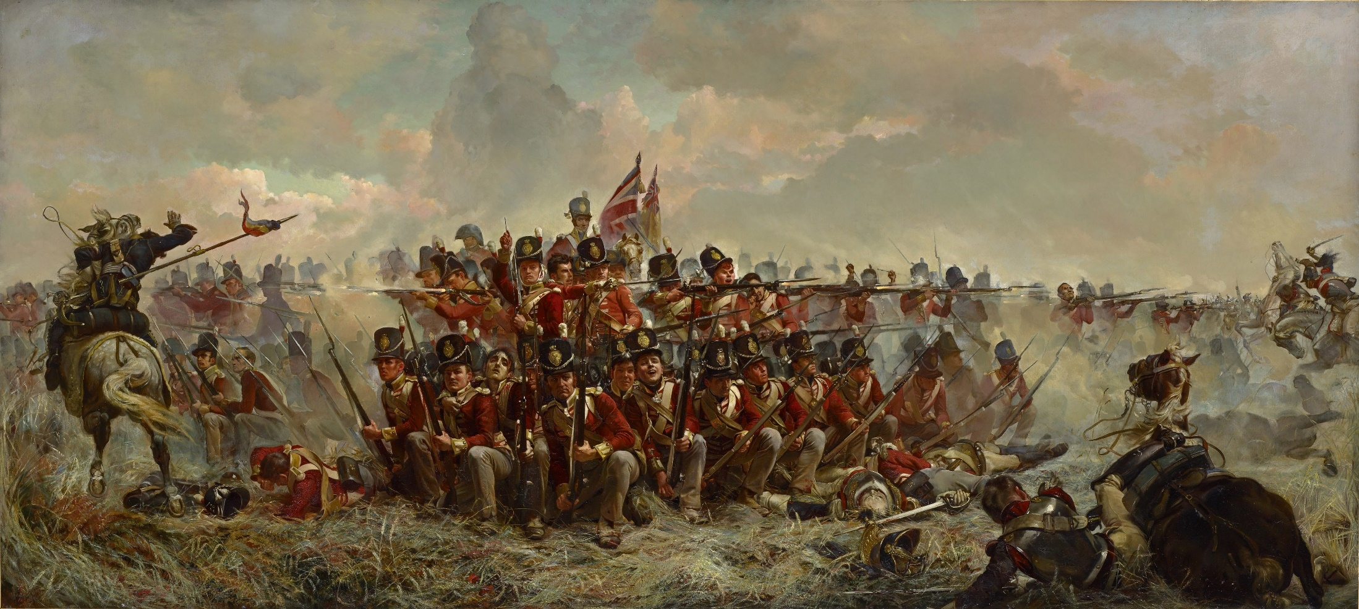
In your book, create a bubble map of what you think it was like to be in a battle during the Napoleonic era.
Think about:
What you can see?
How do the soldiers look?
What is happening around them?
How would they feel?

Slide 2
The experience of battle in the Napoleonic Wars
LO: To use source analysis to investigate what battle was like during the Napoleonic Wars
How were battles won during the Napoleonic Wars?
What challenges did soldiers face during the Napoleonic Wars?
What issues are there with sources from the Napoleonic Wars?

Slide 3
Line formation
Follow these instructions
There need to be two ranks
There needs to be enough space for someone to pass each person
There need to be 3 officers to give orders (think about the best place to position these)
The line needs to be straight
I also need 4 volunteers to be the enemy:
2 artillerymen / women
2 cavalrymen / women

Slide 4
Create a quick sketch of the line formation
Annotate your sketch with:
Details about what the people in each rank do
Explanations of the advantages of the formation
Explanations of the disadvantages of the formation
Make sure that you have subheading to show what your formation is called
Hint - Think about:
cavalry,
artillery,
the number of people who can fire,
how easy it is to move as a unit in this formation

Slide 5
Square formation
Follow these instructions
The square must have two ranks
The front rank must kneel
The sides of the square have a total of six people per side
You also need 2 officers to inspect the square and make sure that the ranks are straight
You have 45 seconds to form the square.
Extension: Try going from line formation to square formation without ‘breaking ranks’ (people leaving the line). This will mean that the

Slide 6
Create a quick sketch of the square formation
Annotate your sketch with:
Details about what the people in each rank do
Explanations of the advantages of the formation
Explanations of the disadvantages of the formation
Make sure that you have subheading to show what your formation is called
Hint - Think about:
cavalry,
artillery,
the number of people who can fire,
how easy it is to move as a unit in this formation

Slide 7
Where do you place your men?
The enemy artillery (long range guns) are on the hill opposite.
The enemy are about to send their infantry (foot soldiers) to attack you
On your mini-whiteboard, pick the best location to position your men, and explain your answer
S+C: Which battle formation should you use?
B
Enemy artillery
C
A

Slide 8
Create a freeze frame based on this quote:
From a letter written by a French soldier, a few days after a battle. He is describing the moment that the French lost an important battle.
“Suddenly someone cried out ‘the Guard [the best unit in the French army] retreats’. Some said it was impossible – the guard had never been beaten before. “Then we have been betrayed” a man next to me shouted. No-one listened to reason and I was forced backwards by a stream of panicking soldiers. There was nothing I could do.”
Can we trust what this person says? Why / Why not?
What might stop his account from being reliable?
What is the purpose of this account? How does it affect how useful this source is?

Slide 9
Create a freeze frame based on this quote:
A comment by a British soldier who fought in a number of battles against the French. This comes from his memoir, written a 35 years after the end of the war. People made a lot of money by selling their memoirs about the Napoleonic Wars.
“The French were powerless to resist the superior skill of our musket fire. They fled like scattering chickens when we charged them with bayonets”
Can we trust what this person says? Why / Why not?
What might stop his account from being reliable?
What is the purpose of this account? How does it affect how useful this source is?

Slide 10
Create a freeze frame based on this quote:
Extract from Sharpe’s Waterloo, a novel by Bernard Cornwell, set in the Napoleonic era:
“Out of the cannon smoke, French cavalry launched themselves at the British line. Officers screamed desperately at the men to form square, but it was too late. Like a wave of horse, man and steel, the French smashed into the British, enveloping them, shattering them. Men tried desperately to defend themselves against the steel blades of the French that came crashing down on their heads. Others fled in panic, only to be ridden over by laughing Frenchmen”.
Can we trust what this person says? Why / Why not?
What might stop his account from being reliable?
What is the purpose of this account? How does it affect how useful this source is?

Slide 11
What was battle like in the Napoleonic era?
Write summary of what you have learnt today.
You could do this as a report, a diary, or an interview
Discuss :
What it was like to be in a battle?
What challenges did you face?
What horrible things did people experience?
Are there any issues which make it hard to trust the sources?

Slide 12
To finish off: PMI
Plus: What challenge did you overcome today?
Minus: One skill from today’s lesson that you need to work on. How will you achieve this?
Interesting: One thing that you found interesting in today’s lesson

