Slide 1
What do the lyrics of ‘Rule Britannia’ suggest about what the British felt about their country?
When Britain first, at heaven's command, Arose from out the azure main, This was the charter of the land, And Guardian Angels sang this strain:
Rule, Britannia! Britannia, rule the waves! Britons never, never, never shall be slaves.
The nations not so blest as thee Must, in their turn, to tyrants fall, While thou shalt flourish great and free: The dread and envy of them all.
Rule, Britannia! Britannia, rule the waves! Britons never, never, never shall be slaves.
Struggling?: What is the mood of the song? How could this tell us about the message of the song?
S+C: How useful are the lyrics of ‘Rule Britannia’ to a historian? Explain your answer.
Notes:
https://www.youtube.com/watch?v=yHNfvJc99YY

Slide 2
The Battle of Trafalgar
LO: To understand how the British won the Battle of Trafalgar
Key Questions:
Why did the Battle of Trafalgar take place?
What tactics were used during the Battle of Trafalgar?
Why did the British win the Battle of Trafalgar?

Slide 3
Your Task:
Pick one factor which you think made the British government MOST worried, one which made the British government the LEAST worried
For each factor, write a sentence explaining why you have put it in that category
You have 5 minutes
Napoleon introduced the ‘Continental System’, which stopped all European trade with Britain. Trade fell by nearly 55%
Napoleon had formed an alliance with Spain, and the two countries had combined their navies into a huge fleet of 33 ships
Napoleon reformed the economy, the legal system, the church, and government in the Code Napoleon.
Napoleon was one of the greatest military generals of his time, and won many great victories in Europe.
Until Napoleon could not defeat the Royal Navy, he would be stuck in mainland Europe.
Napoleon had all his men ready to invade England. He just need to transport them across the English Channel
Napoleon stole art from across the many countries he conquered.
Napoleon planned to invade Great Britain
Toughie Task: Create a shape of significance out of all of these facts, with the most important at the top, and the least important at the bottom

Slide 4
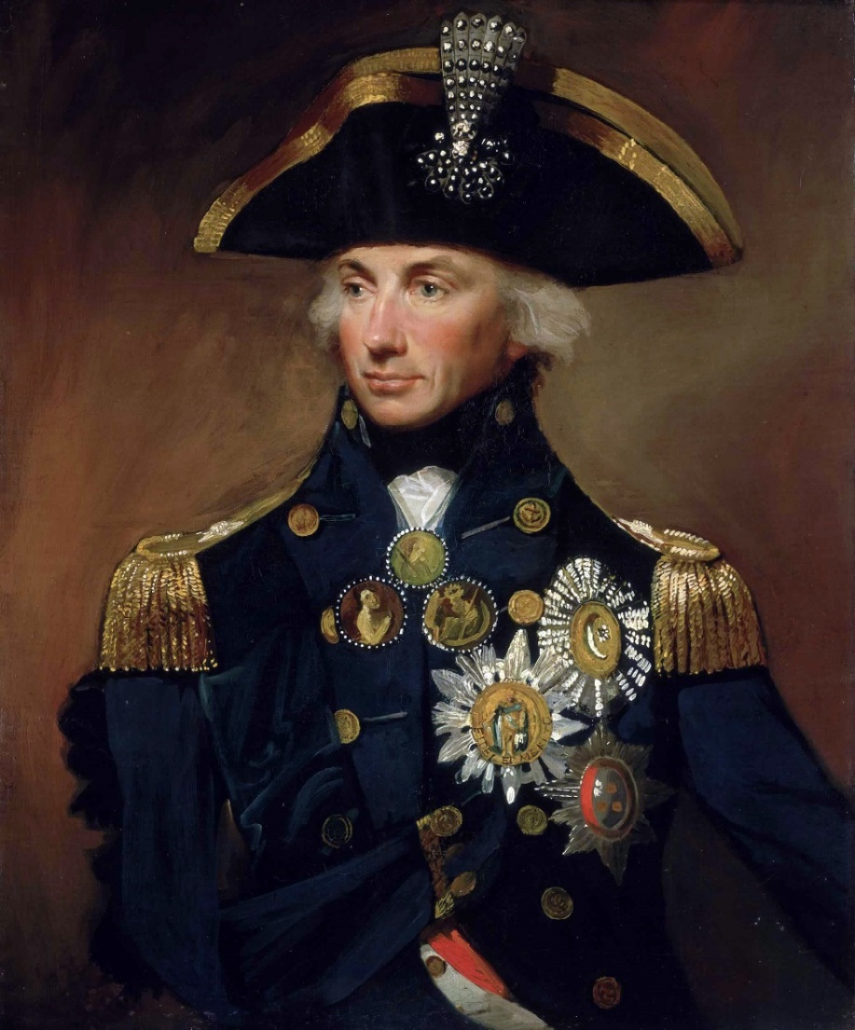
The British government turn to the Royal Navy
Horatio Nelson (1758 – 1805)
One of Britain’s best admirals ever.
Trapped Napoleon in Egypt after destroying the French fleet at the Battle of the Nile
Tracked and chased the new French fleet from Spain, to the Caribbean and back again in 1805.
Came up with a bold plan – attack at right angles to the enemy and fire into their undefended bow or stern (known as raking), instead of sailing up from the side and exchanging broadsides.

Slide 5
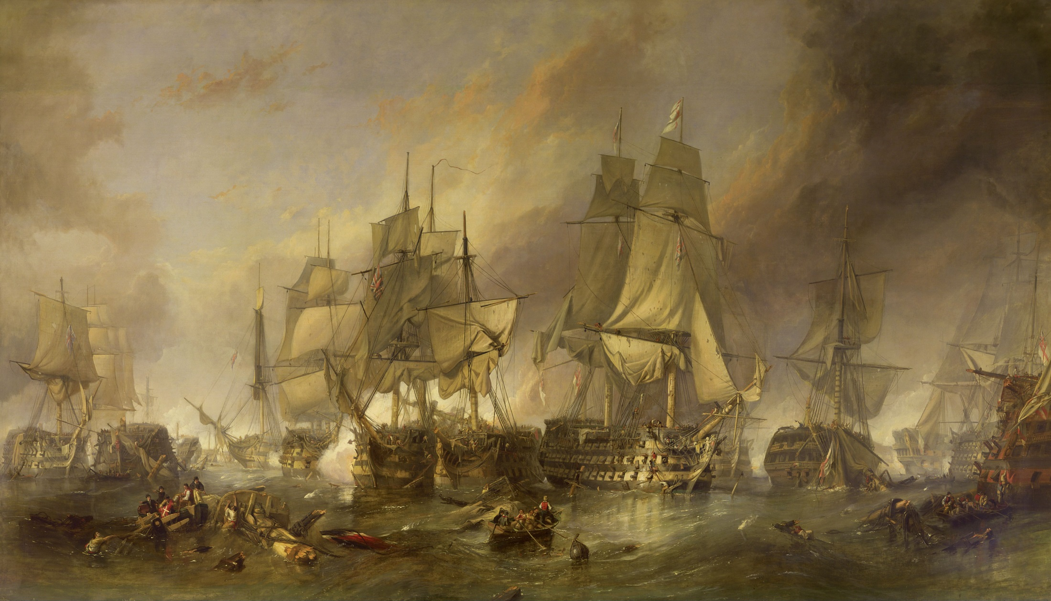
21st October 1805 – The Battle of Trafalgar

Slide 6
Bow – no cannons
Port side cannon range
Starboard side cannon range
Ship
Cannons firing one after another is called a broadside
Stern – no cannons
If you had to attack this ship, how would you do it?
Think about where the vulnerable parts of the ship are.

Slide 7
Why might the wind coming from this direction be a problem?
What affect might this have on the speed of your ship?
Port side cannon range
Starboard side cannon range
Ship
Masts – sails are mounted on these to catch the wind which moves the ship forward

Slide 8
IN A MOMENT:
You will get into groups. Each group is part of a team that will try to guide their naval vessel to victory.
Each team will be given specific advice about their advantages, and disadvantages.
Pay close attention to the ‘Top Tactical Tip’ that I have given each team

Slide 9
BUT FIRST: The rules
Each team will take it in turns to move.
On each turn you can either steer, steer and fire, or load your guns.
If you decide to load your guns you can do NOTHING ELSE that turn
(so plan ahead and choose the moment to load carefully)
You will move faster if you have the wind behind you
On each turn the group’s decision must be written on the mini-whiteboard before the 60 seconds is up. However, the captain will be given the opportunity to change their teams decision if they wish.
The Captain’s decision is FINAL

Slide 10
The Crews
HMS Mr White
HMS Miss Hawker
SS Mr Tarr
Captain: N. Rocha
First Officer: T. Coehlo
Naval Advisers:
Jake, Zara, Filipe
Captain: D. Johnys
First Officer: O. Borisov
Naval Advisers:
Chelsea, Vince,
Captain: M Webb
First Officer: P. Hurst
Naval Advisers:
Yuki, Roberto
First Officers: It is your job to make sure that no-one on your team is talking when someone else is. Your team will lose a turn if I catch someone being rude. You also have the power to send out people from other teams who are being rude or silly

Slide 11
You are about to see what a broadside was like
Create a bubble map on what it was like.
Think about:
How would you describe the noise?
How you would have felt?
What would damage would this cause to the enemy?
How would the enemy feel after facing this?
https://www.youtube.com/watch?v=ZnomDilySlA

Slide 12
What was the name of the major naval battle which you have learnt about today?
On what date did that battle occur?
Give one reason why the British government might be worried about Napoleon.
What was a ‘broadside’?
Why was ‘raking’ a clever thing to do to the enemy in a naval battle?
Define manoeuvre
Use two words to describe what a broadside looked and sounded like? (1 mark for each)
If the Captain ordered ‘Hard-a-Starboard’, which direction would the ship turn in?
Which was better: A small, fast ship with only a few guns, or a big, slow ship with a lot of guns? Why? (You must give a reason to get the mark)
State one thing which you found difficult in today’s naval battle task.

Slide 13
To finish off:
On your post-it note:
Plus – Write down something which you think you did well in this lesson
Minus – Something which you think you could have done better in this lesson. How will you improve on this next time? lesson
Interest – Something which you thought was interesting in this lesson

Slide 14
HMS Mr White
HMS Mr White
A small, fast ship with 30 guns (the fewest of the three in this battle)
Your main aim: Manoeuvre into a position where you can fire into the front or back of the French ship (raking)
You have an ally in HMS Miss Hawker, which has 45 guns
Top Tactical Tip: If you combine with the other British ship, you will outgun SS Mr Tarr, but if you take on the SS Mr Tarr on your own, you will be severely damaged.
Special Move: You can send a message to HMS Mr White, but you can only do this once, and you will only be able to steer on that turn
A small, fast ship with 30 guns (the fewest of the three in this battle)
Your main aim: Manoeuvre into a position where you can fire into the front or back of the French ship (raking)
You have an ally in HMS Miss Hawker, which has 45 guns
Top Tactical Tip: If you combine with the other British ship, you will outgun SS Mr Tarr, but if you take on the SS Mr Tarr on your own, you will be severely damaged.
Special Move: You can send a message to HMS Mr White, but you can only do this once, and you will only be able to steer on that turn
Rules: Captain’s decision is final
First Officer must stop anyone on the team from speaking out of turn
If you want to load your cannons, you cannot steer on that turn
Rules: Captain’s decision is final
First Officer must stop anyone on the team from speaking out of turn
If you want to load your cannons, you cannot steer on that turn

Slide 15
HMS Miss Hawker
HMS Miss Hawker
A medium size ship with 45 guns
Your main aim: Either manoeuvre into a position where you can fire into the front or back of the French ship (raking). Or fire into the side of the SS Mr Tarr (broadside-to-broadside).
You have an ally in HMS Mr White, which has 30 guns
Top Tactical Tip: If you combine with the other British ship, you will outgun SS Mr Tarr.
Special Move: You can send a message to HMS Mr White, but you can only do this once, and you will only be able to steer on that turn. This message can be sent in secret, and HMS Mr White will be able to respond.
A medium size ship with 45 guns
Your main aim: Either manoeuvre into a position where you can fire into the front or back of the French ship (raking). Or fire into the side of the SS Mr Tarr (broadside-to-broadside).
You have an ally in HMS Mr White, which has 30 guns
Top Tactical Tip: If you combine with the other British ship, you will outgun SS Mr Tarr.
Special Move: You can send a message to HMS Mr White, but you can only do this once, and you will only be able to steer on that turn. This message can be sent in secret, and HMS Mr White will be able to respond.
Rules: Captain’s decision is final
First Officer must stop anyone on the team from speaking out of turn
If you want to load your cannons, you cannot steer on that turn
Rules: Captain’s decision is final
First Officer must stop anyone on the team from speaking out of turn
If you want to load your cannons, you cannot steer on that turn

Slide 16
SS Mr Tarr
SS Mr Tarr
A large, but slow ship with 60 guns (the most guns on any ship in this battle)
Your main aim: Do whatever you need to do to survive!
Top Tactical Tip: Together the British ships out gun you, but if you can take on each ship separately, YOU will outgun THEM! Make use of the wind.
Special Move: You can fire both broadsides at the same time, but you can only do this once.
A large, but slow ship with 60 guns (the most guns on any ship in this battle)
Your main aim: Do whatever you need to do to survive!
Top Tactical Tip: Together the British ships out gun you, but if you can take on each ship separately, YOU will outgun THEM! Make use of the wind.
Special Move: You can fire both broadsides at the same time, but you can only do this once.
Rules: Captain’s decision is final
First Officer must stop anyone on the team from speaking out of turn
If you want to load your cannons, you cannot steer on that turn
Rules: Captain’s decision is final
First Officer must stop anyone on the team from speaking out of turn
If you want to load your cannons, you cannot steer on that turn

Slide 17
Port side cannon range
HMS Mr White
Starboard side cannon range
Port side cannon range
HMS Miss Hawker
Starboard side cannon range

Slide 18
Port Side cannon range
Starboard side cannon range
SS Mr Tarr

