Slide 1
Should History teachers care about Geography? Why? Why does geography matter in war?
S+C: Why hasn’t Britain been successfully invaded since 1066?

Slide 2
Napoleon’s Military Career
LO: To investigate how and why Napoleon’s success on the battlefield changed.

Slide 3
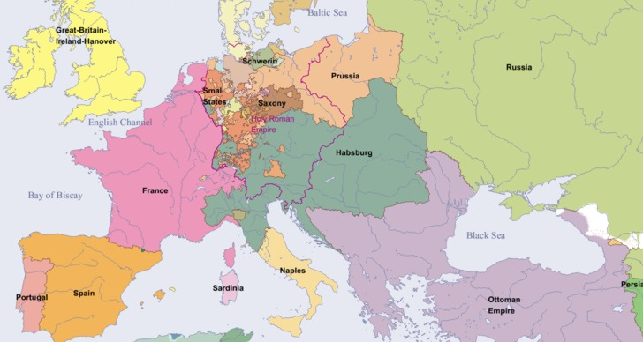
Using the atlas and the text:
Plot the location of the different battles
Colour code each battle as a French victory or an allied victory
Label each battle, and provide a key which explains what happened in each battle, and the number of casualties
S+C: Why was the invasion of Russia the most important turning point in Napoleon’s career? Explain your answer
Key
1. Battle of St Peter’s School, Mr Tarr’s army defeated the army of Mr Todd, Mr Tarr lost 5 soldiers, Mr Todd lost 67,400 soldiers
1

Slide 5
You need to refer to:
Marengo
Trafalgar
Austerlitz
Friedland
Salamanca
Wagram
Borodino
Leipzig

Slide 6
Power graph
For each battle, plot it on this graph to show what effect it had on Napoleon’s power
S+C: How important do you think the Peninsular War was in Napoleon’s defeat? Explain your answer
Power
Date

Slide 7
15 minutes – choose your task
Create a newspaper report, dated 1813, on Napoleon’s military career since he became emperor
Discuss:
His early victories
The invasion of Russia
The Peninsular War
How the allies have responded
Remember –
Headline
Sub headings
Facts and detail
Picture (do this last)
S+C: Try writing either from a French or British perspective.
How will what you say differ depending on your perspective?
Create a BBC News report, from 1813, on the latest developments of Napoleon’s career.
Discuss
What has changed for Napoleon
Why have things changed?
What problems does he now face?
An interview with either British commander the Duke of Wellington, or Napoleon himself
Remember – Headline, Facts and detail, Explanation, Stage directions
Hint: Think about the different perspectives of Wellington and Napoleon

Slide 8
On your mini-whiteboards:
“Geography was the most important factor that limited Napoleon’s success.”
To what extent do you agree with this statement?

Slide 9
