Slide 1
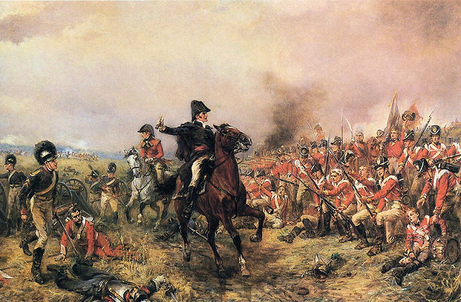
On your mini-whiteboards:
Why do you think these people are here?
When might this event have happened?
How do you think the soldiers might be feeling?
Who do you think the man might be?
What is he trying to do?
S+C: How reliable is this source is? Explain your answer. (Hint: think about who might have created it and why)
You have 4 minutes

Slide 2
The Battle of Waterloo 1815
LO: To investigate how the Allies won the Battle of Waterloo.
All – Will be able to describe three tactics which Wellington used in order to win the battle
Most – Will be able to explain why those tactics were important in helping the Allies win
Some – Will be able to evaluate the importance of these tactics in helping the Allies win

Slide 3
Your Task:
I am about to split you into groups.
Around the room are three stations, each of which looks at a different phase of the battle.
You will have 10 minutes to complete the table for the phase which you have been allocated.
You will be teaching one another later, so make sure that you know your stuff
Struggling? Finished?: See my Stretch and Support tasks

Slide 4
 | Definitions | What happened | How did this impact on the battle?
Phase 1
Phase 2
Phase 3
Phase 4

Slide 5
Your Task
Return to your groups.
You now have 5 minutes each to teach one another about the phase of the battle which you have investigated
If you finish, attempt the S+C activity at any workstation

Slide 6
The Battle of Waterloo 1815
LO: To investigate how the Allies won the Battle of Waterloo.
All – Will be able to describe three tactics which Wellington used in order to win the battle
Most – Will be able to explain why those tactics were important in helping the Allies win
Some – Will be able to evaluate the importance of these tactics in helping the Allies win

Slide 7
Napoleon was always going to lose the Battle of Waterloo’. Do you agree
We are going to debate this question.
You have 5 minutes to prepare any notes to help you in the debate
Struggling?: Think about:
Was Napoleon’s strategy ever likely to work?
What was it that helped the Allies win?
Was Waterloo a British or an Allied victory?

Slide 8
Phase 1: The Return of the Emperor
In 1814, Napoleon had been forced to abdicate after a number of countries combined into a Coalition and invaded France. He was exiled to the island of Elba, but returned in March 1815, when it became clear that the French people were unhappy with Louis XVIII, who had been made King of France. The whole army joined Napoleon at once, but the people of France were not that excited to see Napoleon.
In order to reclaim France’s position of power, Napoleon needed to fight off France’s enemies. However, the countries of Europe united in the face of this new threat. They created the Seventh Coalition (Britain, Prussia, Austria and Russia), and prepared for war
Napoleon knew that he could not defeat all the Allies at once, so he decided to start by attacking the medium sized British and Prussian armies which were based in Belgium. On 15th June 1815 Napoleon invaded Belgium

Slide 9
Phase 2: The Invasion Begins
The British and Prussian armies based in Belgium had a total combined strength of around 250,000 men. Together, they outnumber Napoleon, but individually, he outnumbered each of them.
Stretch and Challenge:
At this stage of the battle, who do you think was the most likely to win? Explain your answer
Napoleon decided to launch his army into a gap between the British and the Prussians. He hoped that by doing this he would split them up, and could then encircle each army in turn and defeat it
Napoleon’s plan was very daring, and it took the Allies completely by surprise. Wellington said he had been ‘humbugged, by God!’ However, Napoleon’s plan didn’t work. The French fought two twin battles on the 16th June 1815 at Quatre Bras and Ligny. Losses were heavy for all the nations, and the Prussians had no choice but to retreat and regroup. However, Marshall Blucher, the commander of the Prussian army, decided to stay close to the British Army (commanded by Wellington). Wellington agreed that he would fight Napoleon if Blucher promised to help him. On 18th June 1815, the Battle of Waterloo began!.
Key definitions:
Retreat – pull back
Regroup – reorganise so that you can carry on
Commanded – led by
Humbugged – out witted

Slide 10
Phase 3: Farms, Guns and Thunderstorms
The night before the 18th June 1815, there was a huge thunderstorm. It soaked the ground, and on the morning of 18th June, Napoleon decided to delay his attack to wait for the ground to dry out, so that it would be easier to move his men around. As Wellington was waiting for help from the Prussians, this was good news. The thunderstorm also boosted the morale of the British troops, as some of Wellington’s most famous victories had been preceded by thunderstorms
Stretch and Challenge:
At this stage of the battle, who do you think was the most likely to win? Explain your answer
At 11:45am on 18th June 1815 Napoleon began the Battle of Waterloo with a cannonade of the British forces. The wet ground soaked up some of the cannonballs, and Wellington cleverly position his men on the reverse side of a slope so that they were harder for the French to hit.
Wellington had also cleverly chosen to fight in a place where there were three farms to protect the front of his position (Hougoumont, La Haye Sainte and Papelotte). He garrisoned these with his elite troops, and used them as breakwaters, forcing the French to attack certain areas of his line, which meant that he could concentrate his forces. Despite this, when the French did attack with their infantry, they very nearly broke through – the fate of the battle was hanging in the balance
Key terms
Infantry – foot soldiers
Garrison – position troops in a building
Concentrate – bring lots together in one place
Elite – the best
Cannonade – firing lots of cannons at one target

Slide 11
Phase 4: Death and Glory
The French infantry attack on the British line almost succeeded, so Wellington sent in the British cavalry. This annihilated the French units attacking the British, but the cavalry became overconfident and charge all the way to the French lines. They were cut off by the French cavalry, and hundreds were killed.
Stretch and Challenge:
At this stage of the battle, who do you think was the most likely to win? Explain your answer
However, soon the French made a huge mistake. When Wellington decided to pull some of his men back to protect them from French cannons, the French assumed that the British were retreating, and sent all of their cavalry to attack the British. In fact, the British infantry simply made square formations to protect themselves against the cavalry. Instead of realising their mistake, the French sent more and more cavalry over two hours, without breaking a single square
Key definitions:
Retreat – pull back
Wellington – commander of the British army
Cavalry – soldiers on horseback
Infantry – soldiers on foot
Annihilated – destroyed
Morale – confidence
Discipline – order and obedence
Musket – a gun carried by infantry
Meanwhile the Prussian army, which had been marching to help the British, was now arriving on the French flank at Placenoit. In a last desperate attempt to defeat the British, Napoleon sent in his elite troops, the Imperial Guard. The Guard had never been beaten, but they had never faced the British. The faster rate of musket fire from the British forced the Imperial Guard to retreat. French morale collapsed as news of this spread, and discipline collapsed. The Battle of Waterloo was over, and the French fled into the night.

Slide 12
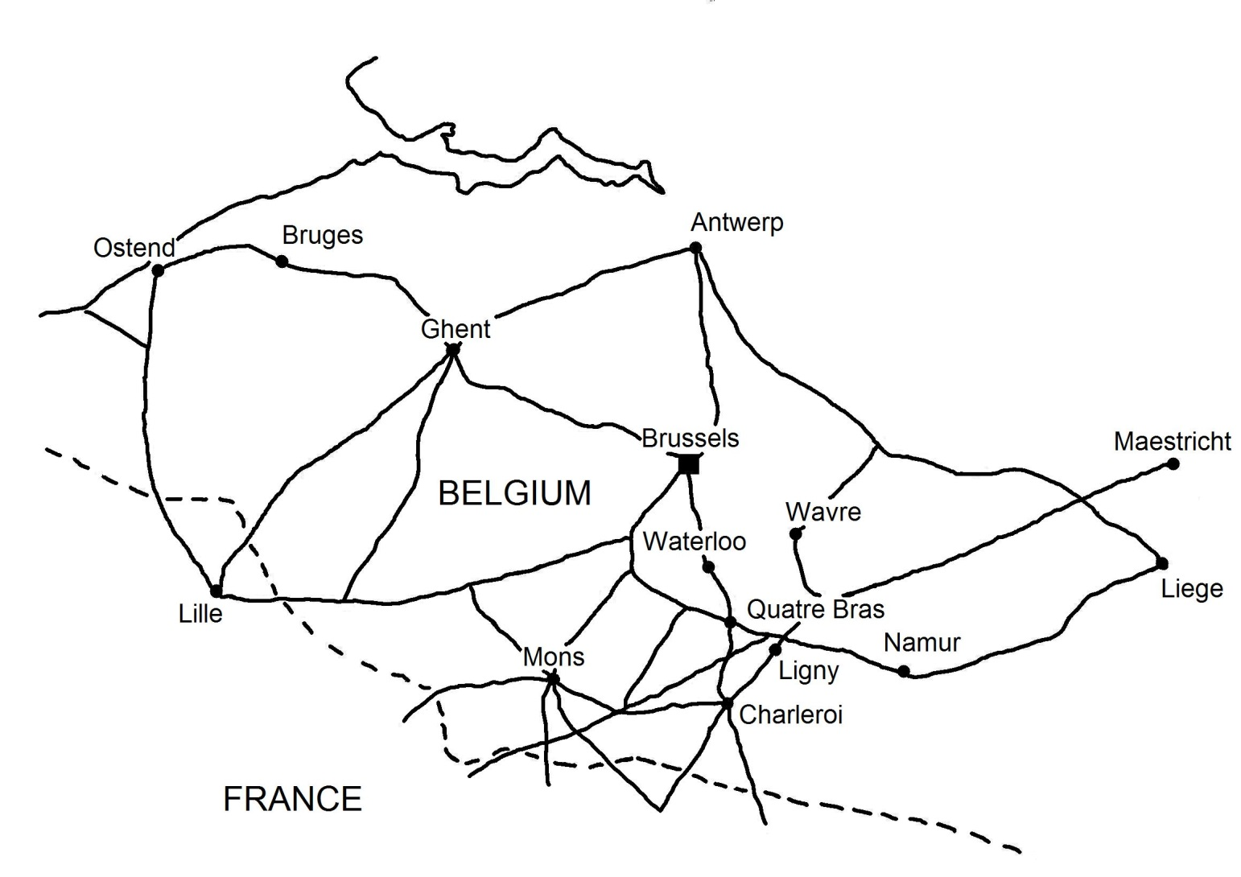
Prussian Army
British Army
French Army

Slide 13
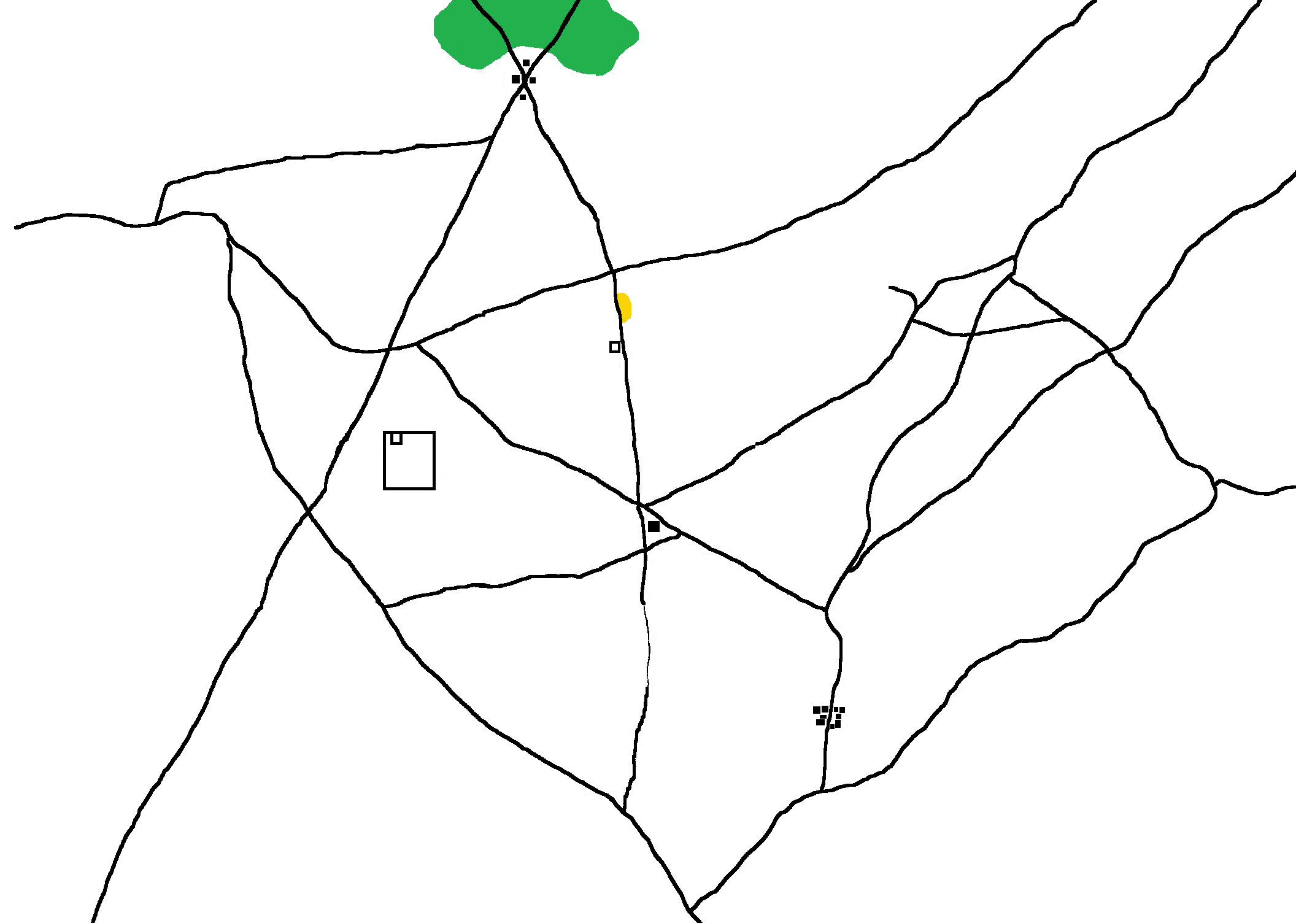
British Army
Papelotte
La Haye Saine
Hougoumont
French Army
Placenoit

